Slide 1
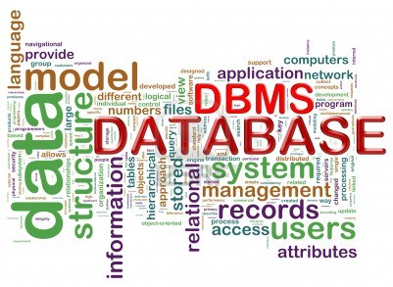
DATABASE Concept
Pawan KC

Slide 2
ACID
Atomicity: A database follows the all or nothing rule, i.e., the database considers all transaction operations as one whole unit or atom. Thus, when a database processes a transaction, it is either fully completed or not executed at all.
Consistency: Ensures that only valid data following all rules and constraints is written in the database. When a transaction results in invalid data, the database reverts to its previous state, which abides by all customary rules and constraints.
Isolation: Ensures that transactions are securely and independently processed at the same time without interference, but it does not ensure the order of transactions. For example, user A withdraws $100 and user B withdraws $250 from user Z’s account, which has a balance of $1000. Since both A and B draw from Z’s account, one of the users is required to wait until the other user transaction is completed, avoiding inconsistent data. If B is required to wait, then B must wait until A’s transaction is completed, and Z’s account balance changes to $900. Now, B can withdraw $250 from this $900 balance.
Durability: In the above example, user B may withdraw $100 only after user A’s transaction is completed and is updated in the database. If the system fails before A’s transaction is logged in the database, A cannot withdraw any money, and Z’s account returns to its previous consistent state.

Slide 3
Important Terminology & Concept
  Nulls
  Entity integrity
  Relational integrity
  Referential integrity
  General constraints
Notes:
Relational integrity :
Relational integrity is such that if any two relations are on relationship they should follow every aspect of Referential integrity and constraints.
Null:
Represents a value for an attribute that is currently unknown or is not applicable for this tuples. In other word Null is the absence of value.
Entity integrity:
In any entity primary key column(s) cannot be NULL.
Referential integrity:
If a foreign key exists in a relation, either the foreign key value must match a candidate key value of some tuples in its home relation or the foreign key value must be wholly null.
General constraints :
General constraints are the additional rules that is enforced by user or database administrator on some aspect of the enterprise or business.

Slide 4
Redundancy
Dependencies between attributes within a relation cause redundancy
Ex. All addresses in the same town have the same zip code
There's clearly redundant information stored here.
Consistency and integrity are harder to maintain even in this simple example, e.g., ensuring the fact that the zip code always refers the same city and the city is spelled consistently.
Note we don't have a zip code to city fact stored unless there is a person from that zipcode
SSN | Name | Town | Zip
1234 | Joe | Huntingdon | 16652
2345 | Mary | Huntingdon | 16652
3456 | Tom | Huntingdon | 16652
5948 | Harry | Alexandria | 16603

Slide 5
Anomalies
An anomaly is an inconsistent, incomplete, or contradictory state of the database
  Insertion anomaly – user is unable to insert a new record of data when it should be possible to do so because not all other information is available.
  Deletion anomaly – when a record is deleted, other information that is tied to it is also deleted
  Update anomaly –a record is updated, but other appearances of the same items are not updated

Slide 6
Deletion and Update Anomalies
What happens if we change the price of Dancing?
StudentID | Activity | Cost
21 | Dancing | $23
21 | Swimming | $50
34 | Dancing | $23
55 | Fencing | $20
What happens if we delete this row?

Slide 7
Splitting the Relation
StudentID | Activity | Cost
21 | Dancing | $23
21 | Swimming | $50
34 | Dancing | $23
55 | Fencing | $20
StudentID | Activity
21 | Dancing
21 | Swimming
34 | Dancing
55 | Fencing
Activity | Cost
Dancing | $23
Swimming | $50
Fencing | $20

Slide 8
Keys In RDBMS
Super Key
Candidate Key
Composite Key
Primary Key
Foreign Key
Unique Key
Notes:
Super Key
A Super key is any combination of fields within a table that uniquely identifies each record within that table.
Candidate Key
A candidate is a subset of a super key. A candidate key is a single field or the least combination of fields that uniquely identifies each record in the table. The least combination of fields distinguishes a candidate key from a super key. Every table must have at least one candidate key but at the same time can have several.

Slide 9
Functional Dependency
Functional dependency is a relationship that exists when one attribute uniquely determines another attribute.
If R is a relation with attributes X and Y, a functional dependency between the attributes is represented as
X->Y
which specifies Y is functionally dependent on X. Here X is a determinant set and Y is a dependent attribute. Each value of X is associated precisely with one Y value.
Functional dependency in a database serves as a constraint between two sets of attributes. Defining functional dependency is an important part of relational database design and contributes to aspect normalization.

Slide 10
EmpNum
EmpEmail
EmpFname
EmpLname
123
jdoe@abc.com
John
Doe
456
psmith@abc.com
Peter
Smith
555
alee1@abc.com
Alan
Lee
633
pdoe@abc.com
Peter
Doe
787
alee2@abc.com
Alan
Lee
If EmpNum is the PK then the FDs:
EmpNum → EmpEmail
EmpNum → EmpFname
EmpNum → EmpLname
must exists

Slide 11
EmpNum → EmpEmail
EmpNum → EmpFname
EmpNum → EmpLname
EmpEmail
EmpNum
EmpFname
EmpLname
EmpNum
EmpEmail
EmpFname
EmpLname

Slide 12
Determinant
Functional Dependency
EmpNum → EmpEmail
Attribute on the LHS is known as the determinant
  EmpNum is a determinant of EmpEmail

Slide 13
Transitive dependency
Transitive dependency
Consider attributes A, B, and C, and where
A → B and B → C.
Functional dependencies are transitive, which means that we also have the functional dependency A → C
We say that C is transitively dependent on A through B.

Slide 14
EmpNum → DeptNum
EmpNum EmpEmail DeptNum DeptNname
DeptNum → DeptName
EmpNum EmpEmail DeptNum DeptNname
DeptName is transitively dependent on EmpNum via DeptNum
    EmpNum → DeptName

Slide 15
Partial dependency
A partial dependency exists when an attribute B is functionally dependent on an attribute A, and A is a component of a multipart candidate key.
Candidate keys: {InvNum, LineNum} InvDate is partially dependent on {InvNum, LineNum} as InvNum is a determinant of InvDate and InvNum is part of a candidate key
InvNum
LineNum
Qty
InvDate

Slide 16
Normalization
        Normalization is a process that “improves” a database design by generating relations that are of higher normal forms.
        The objective of normalization:
        “to create relations where every dependency is on the key, the whole key, and nothing but the key”.

Slide 17
Normalization
1NF
a relation in BCNF, is also in 3NF
a relation in 3NF is also in 2NF
a relation in 2NF is also in 1NF
2NF
3NF

Slide 18
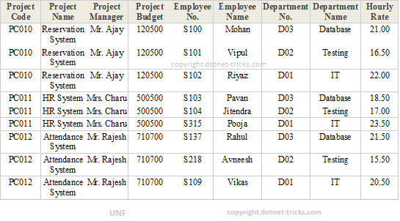
UNNORMAL FORM

Slide 19
First Normal Form
Basic Rule:
  Contains only atomic values
  There are no repeating groups
A database table is said to be in 1NF if it contains no repeating fields/columns. The process of converting the UNF table into 1NF is as follows:
  Separate the repeating fields into new database tables along with the key from unnormalized database table.
  The primary key of new database tables may be a composite key

Slide 20
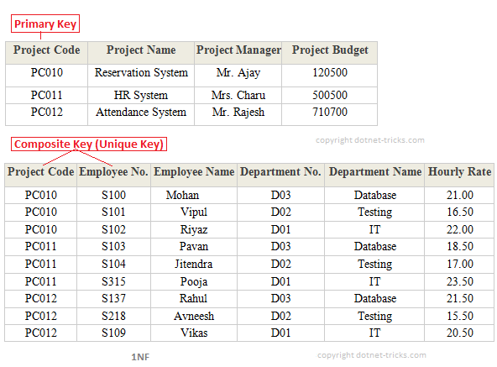
First Normal Form

Slide 21
Activity : First Normal Form
EmpNum | EmpPhone | EmpDegree
123 | 233-9876
333 | 233-1231 | BA, BSc, PhD
679 | 233-1231 | BSc, MSc
How can we make above table in 1st Normal Form

Slide 22
Activity : First Normal Form
EmployeeDegree
Employee
EmpNum
EmpDegree
EmpNum
EmpPhone
333
BA
123
233-9876
333
BSc
333
233-1231
333
PhD
679
233-1231
679
BSc
679
MSc

Slide 23
SECOND Normal Form
Basic Rule:
  It is in first normal form
  All non-key attributes are fully functional dependent on the primary key
A database table is said to be in 2NF if it is in 1NF and contains only those fields/columns that are functionally dependent
Process:
The process of converting the database table into 2NF is as follows:
  Remove the partial dependencies (A type of functional dependency where a field is only functionally dependent on the part of primary key) of any non-key field.
  If field B depends on field A and vice versa. Also for a given value of B, we have only one possible value of A and vice versa, Then we put the field B in to new database table where B will be primary key and also marked as foreign key in parent table.

Slide 24
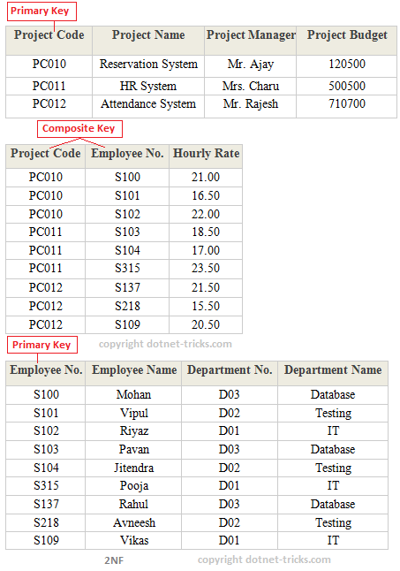
SECOND Normal Form

Slide 25
Activity: SECOND Normal Form
InvNum, LineNum → ProdNum, Qty
There are two candidate keys.
Qty is the only non-key attribute, and it is dependent on InvNum
InvNum → InvDate
a partial dependency of InvDate on InvNum
InvNum
LineNum
ProdNum
Qty
InvDate

Slide 26
Activity: SECOND Normal Form
InvLine
InvNum
LineNum
ProdNum
Qty
InvDate
The above relation has redundancies: the invoice date is repeated on each invoice line.
We can improve the database by decomposing the relation into two relations:
InvNum
LineNum
ProdNum
Qty
InvNum
InvDate

Slide 27
Third Normal Form
Basic Rule
  It is in second normal form
  There is no transitive functional dependency
A database table is said to be in 3NF if it is in 2NF and all non keys fields should be dependent on primary key or We can also said a table to be in 3NF if it is in 2NF and no fields of the table is transitively functionally dependent on the primary key.
Process:
The process of converting the table into 3NF is as follows:
  Remove the transitive dependencies(A type of functional dependency where a field is functionally dependent on the Field that is not the primary key. Hence its value is determined, indirectly by the primary key )
  Make separate table for transitive dependent Field.

Slide 28
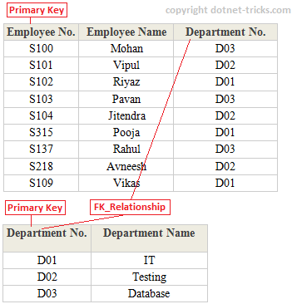
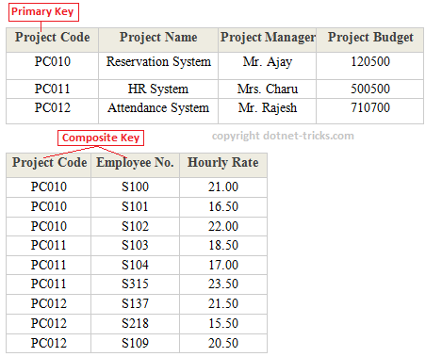
Third Normal Form

Slide 29
Activity: Third Normal Form
EmpNum
EmpName
DeptNum
DeptName
EmpName, DeptNum, and DeptName are non-key attributes.
DeptNum determines DeptName, a non-key attribute, and DeptNum is not a candidate key.

Slide 30
Activity: Third Normal Form
EmpNum
EmpName
DeptNum
DeptName
We correct the situation by decomposing the original relation into two 3NF relations. Note the decomposition is lossless.
EmpNum
EmpName
DeptNum
DeptNum
DeptName
Verify these two relations are in 3NF.

Slide 31
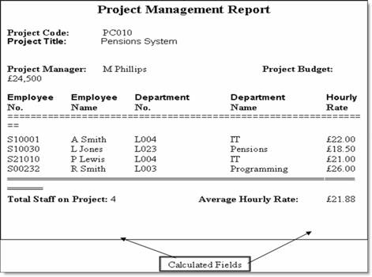
CASE STUDY : Normalization

Slide 32
THANK YOU

